Slide 1

Learning local behavioral sequences to better infer non-local properties in real multi-robot systems
Taeyeong Choi, Sehyeok Kang, and Theodore P. Pavlic
Science and Engineering of Autonomous Decision-making Systems (SEADS) Lab

Slide 2
Remote Teammate Localization (ReTLo)
H
F1
F2
F3
T
Could I infer where all of
my remote teammates are?
I only know about my nearest neighbor, F3 though ..

Slide 3
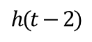
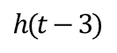
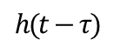
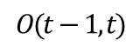
Remote Teammate Localization (ReTLo)
Observation
Prediction
F3’
H
F3
…
F1
T
F2
$$O(t−1, t)$$
H
. . .
F1
Historical sequence
F2
H
H
H
F1
…
F1
F1
F3
F2
F2
F2
F3
F3
F3
T
T
T
T
$$h(t−τ)$$
$$h(t−3)$$
$$h(t−2)$$
Let me use the prior knowledge and current observations !

Slide 4
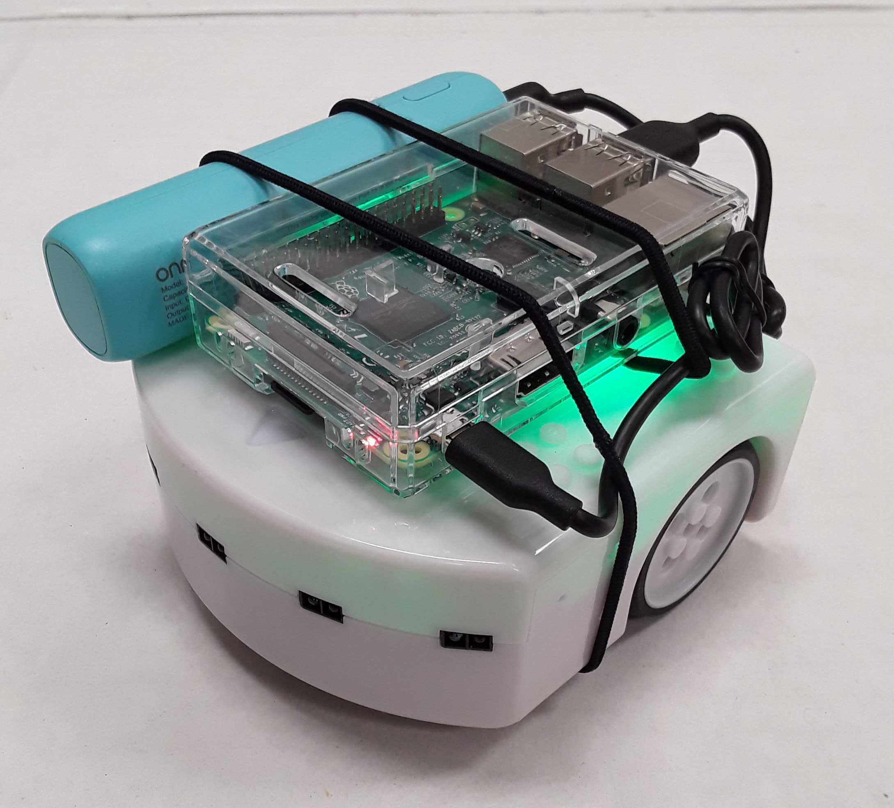

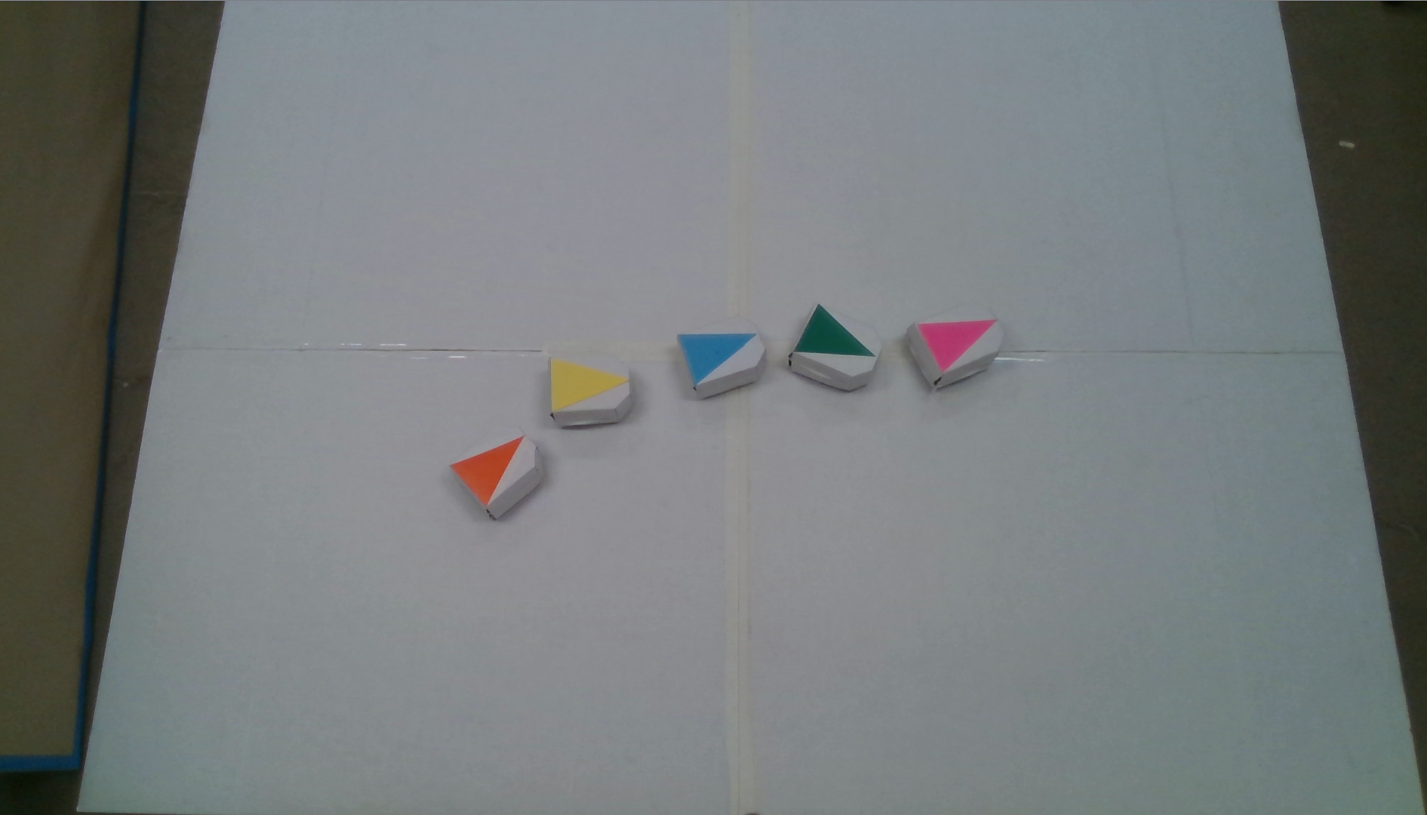


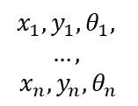
For experiments, we use a commercially available, two wheeled robotics platform, Thymio, equipped with Raspberry Pi.
2.5 meters
$$x_{1},y_{1},θ_{1},$$
$$…,$$
$$x_{n}, y_{n}, θ_{n}$$
1.9 meters
While a team of robots are driven by the Head, a central computer with an overhead camera simulates better proximity sensors and a virtual GPS system.

Slide 5
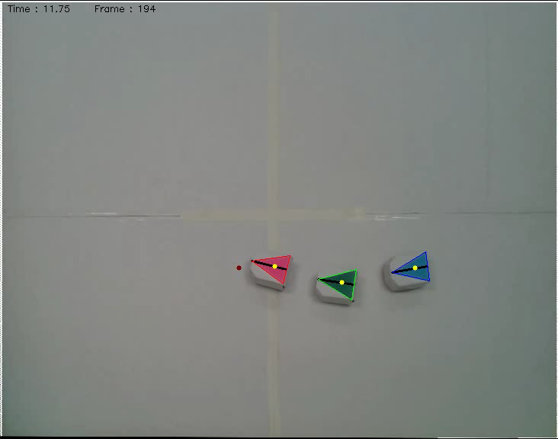
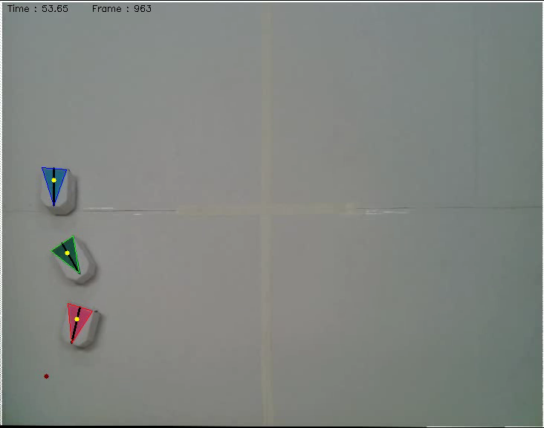
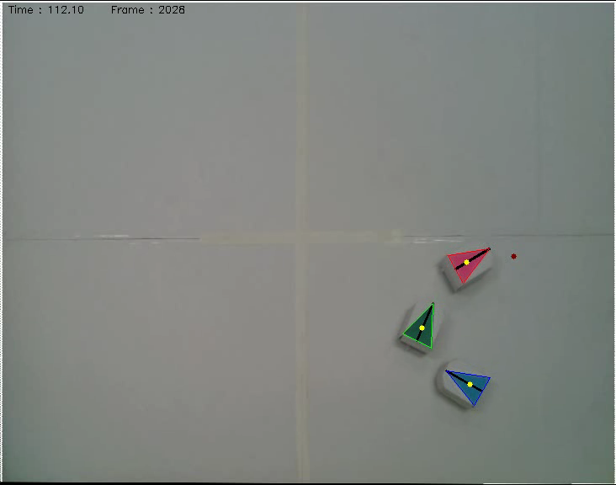
With the collected 12K data samples, our model on Tail learns to predict the pose of Head by using historical team formations and recent observations of Follower
An off-the-shelf detection algorithm is used to collect x,y-coordinates and orientations in a 3-robot team as the Head is moving toward random destinations

Slide 6
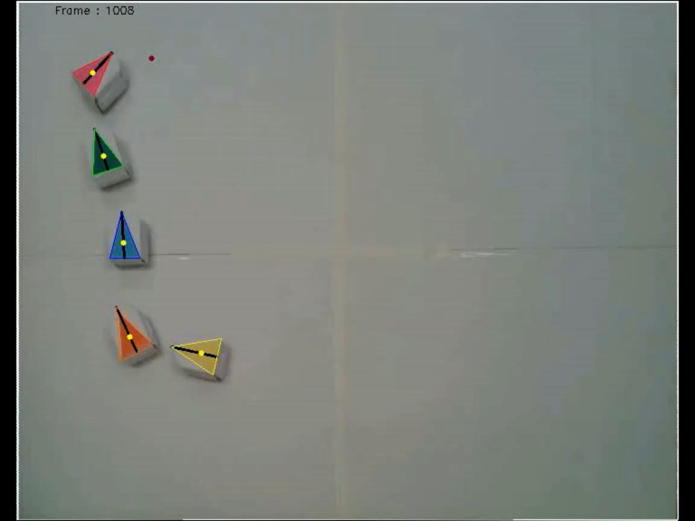

Prediction on a larger team
T=
For first 5 seconds,
the poses of all robots are assumed to be known, which is used as the first history input
Recorded at 2FPS and displayed 2x slower

Slide 7
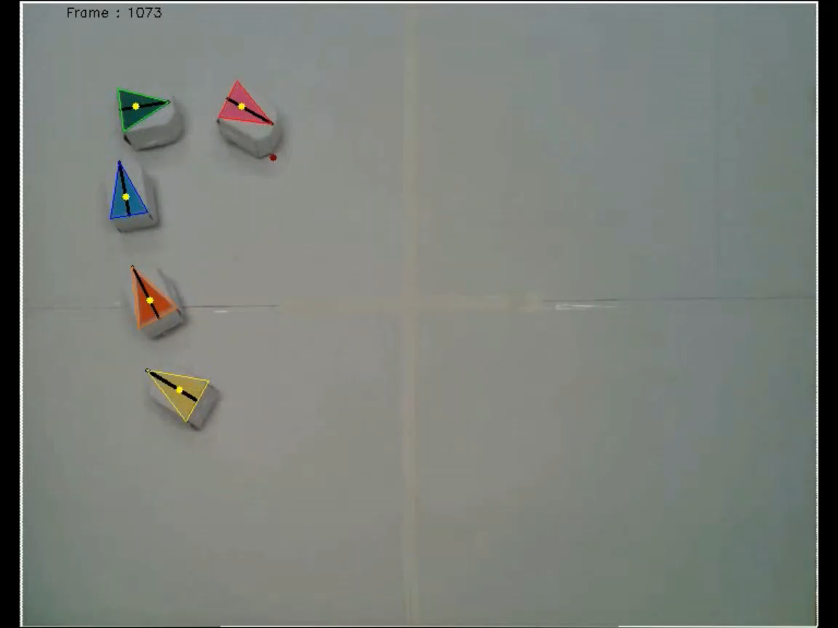

Prediction on a larger team
T=
For first 5 seconds,
the poses of all robots are assumed to be known, which is used as the first history input
Recorded at 2FPS and displayed 2x slower

Slide 8
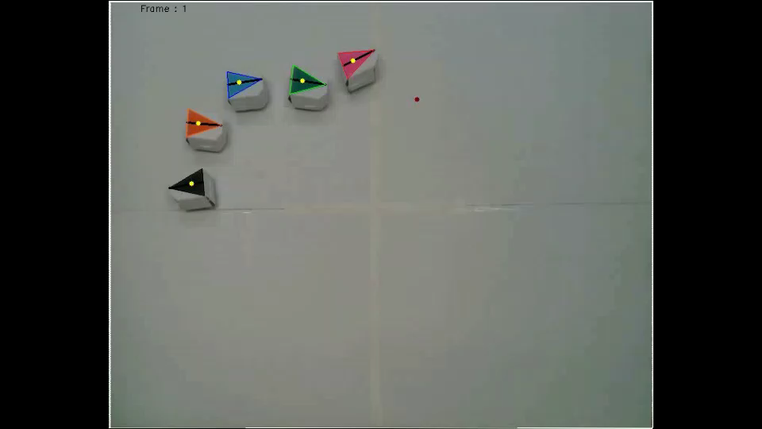
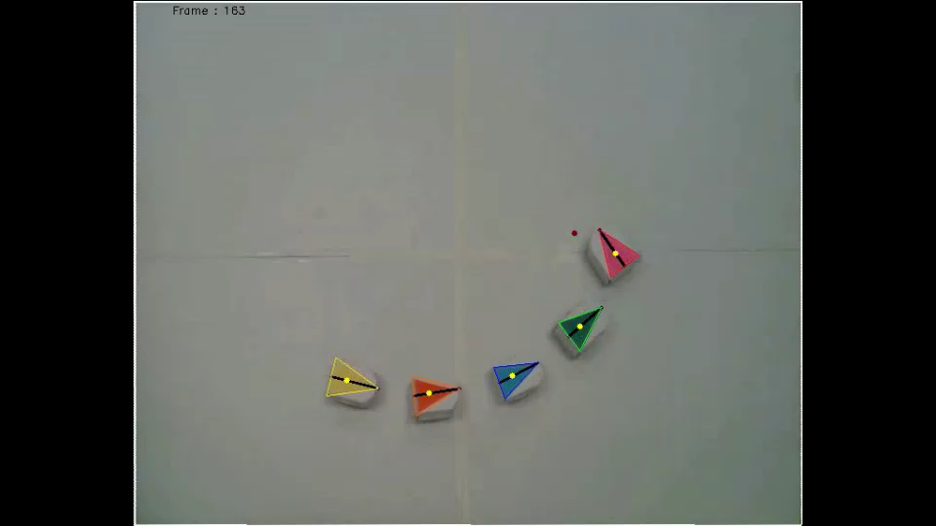
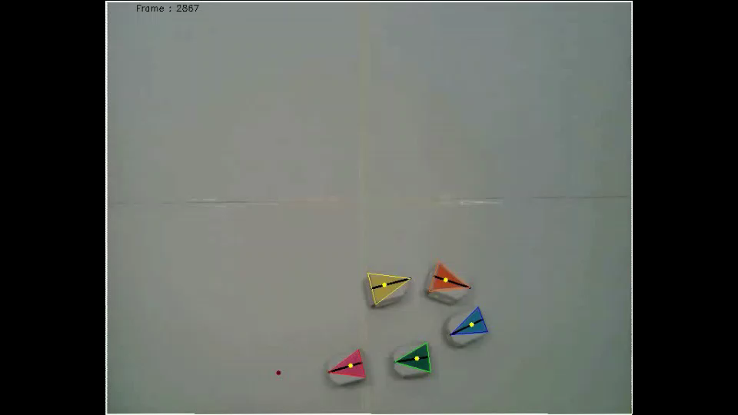
More prediction examples (2x slower speed)

